Slide 1
Applied Data Science
Capstone Project

Slide 2
Business Problem
Recommendation for office location for a distributor of sea food to Chinese restaurants in New York (Manhattan)
Target Audience for this solution are Distributors of sea food
Constraints :
Distributor is selling perishable sea food
Wants to be close to his customers to deliver on an as needed basis

Slide 3
Data used
Used data from the internet which is readily available
data from geo.nyu.edu
Four square for restaurant data

Slide 4
Exploring the Data set
Geo data from geo.nyu.edu
Latitude and longitude data for 40 neighborhoods in Manhattan
This data is used to get the top food venue data from Foursquare
Foursquare Data
Explore API used with “section = food” filter to get data relevant for our business problem

Slide 5
Analyzing the data
Group and classify the data into top common venues for every neighborhood
Use one hot encoding to encode the data so it can be clustered and analyzed

Slide 6
Clustering Neighborhoods
Run K-means to cluster the neighborhoods into 6 clusters
Various cluster numbers are used to do multiple runs to get to the optimal cluster number

Slide 7
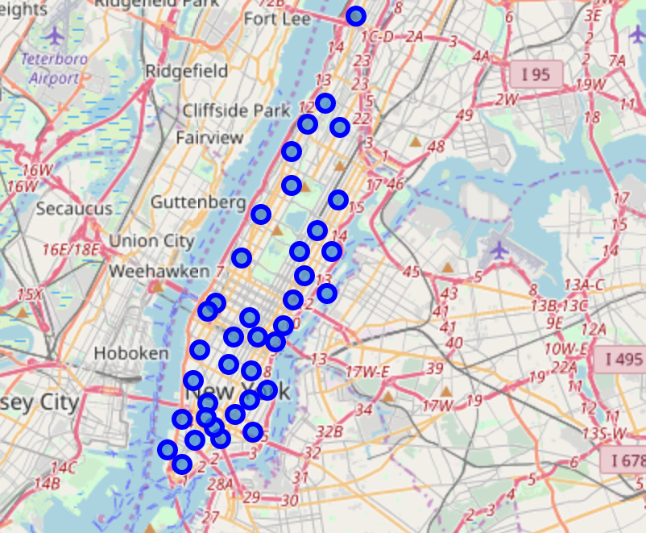
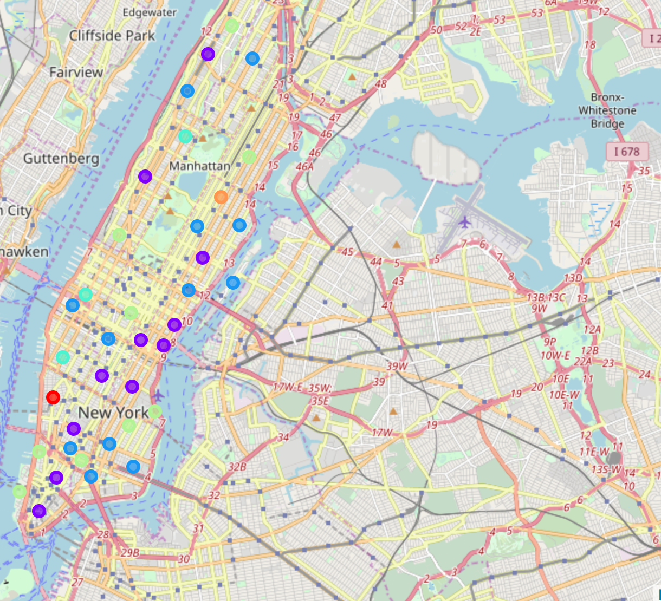



Unanalyzed data
Clustered and Analyzed data
Immediate Expansion area in same cluster
Set up office in this area
Future Expansion area across the bridge

Slide 8
Conclusion
Based on the results it is clear that the distributor should setup office close to China town and Lower East side
This is based on popularity of Chinese restaurants in that cluster
As a immediate expansion they can look at midtown south (in the same cluster)
They can do future expansion to Brooklyn which is across the bridge on the other side

Slide 9
Expansion plan for the business – Additional Analysis beyond the original Business problem

Slide 10
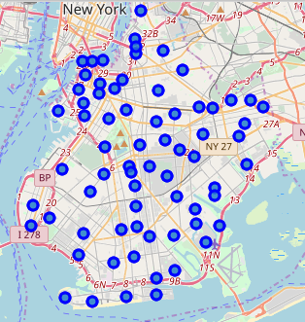
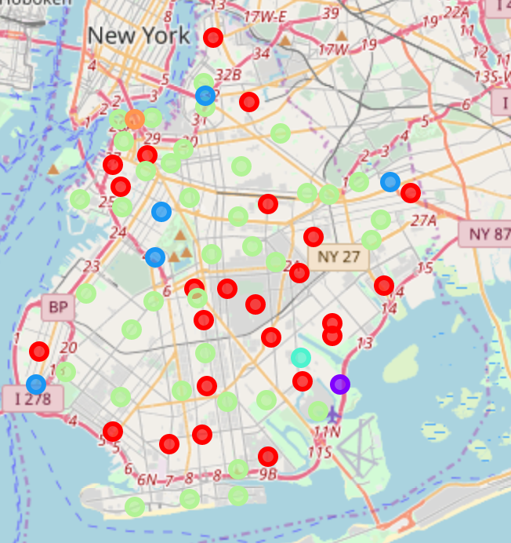
Future Expansion plans - Brooklyn
Future Expansion area across the bridge
Run K-means to cluster the neighborhoods into 6 clusters
Cluster 1 has Chinese restaurants in common venues in multiple neighborhoods. Perfect for the expansion plan in the cluster

Slide 11
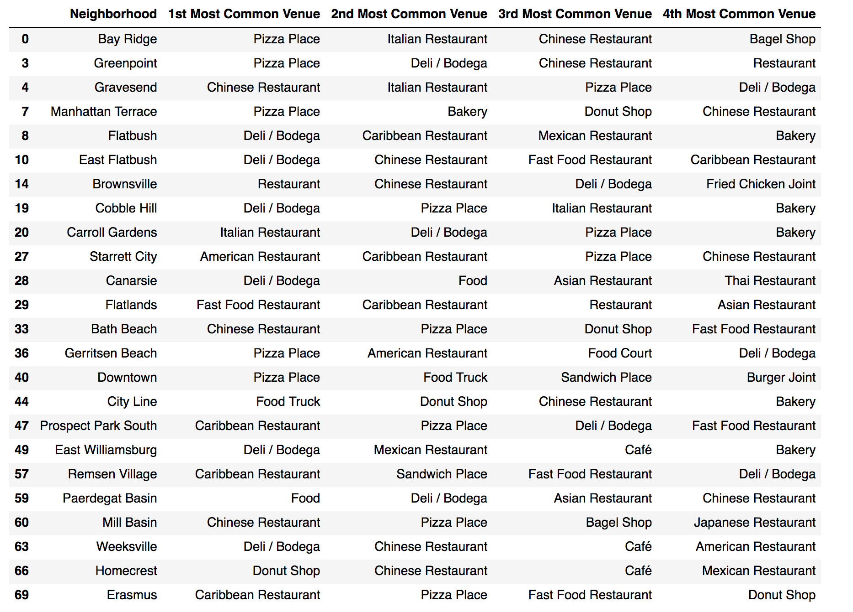
Future Expansion plans - Brooklyn Cluster 1 data

Slide 12
Expansion Plan
Based on the results it is clear that the distributor should setup office close to China town and Lower East side
This is based on popularity of Chinese restaurants in that cluster
As a immediate expansion they can look at midtown south (in the same cluster)
They can do future expansion to Brooklyn which is across the bridge on the other side

Slide 13
Assumptions / Limitations
Four square data has limitation on the number of free API calls
Analyzed Brooklyn and other data from Four square over multiple days because of the above limitation.
Use of paid account should be explored to get all the data in the same run.

